Slide 1
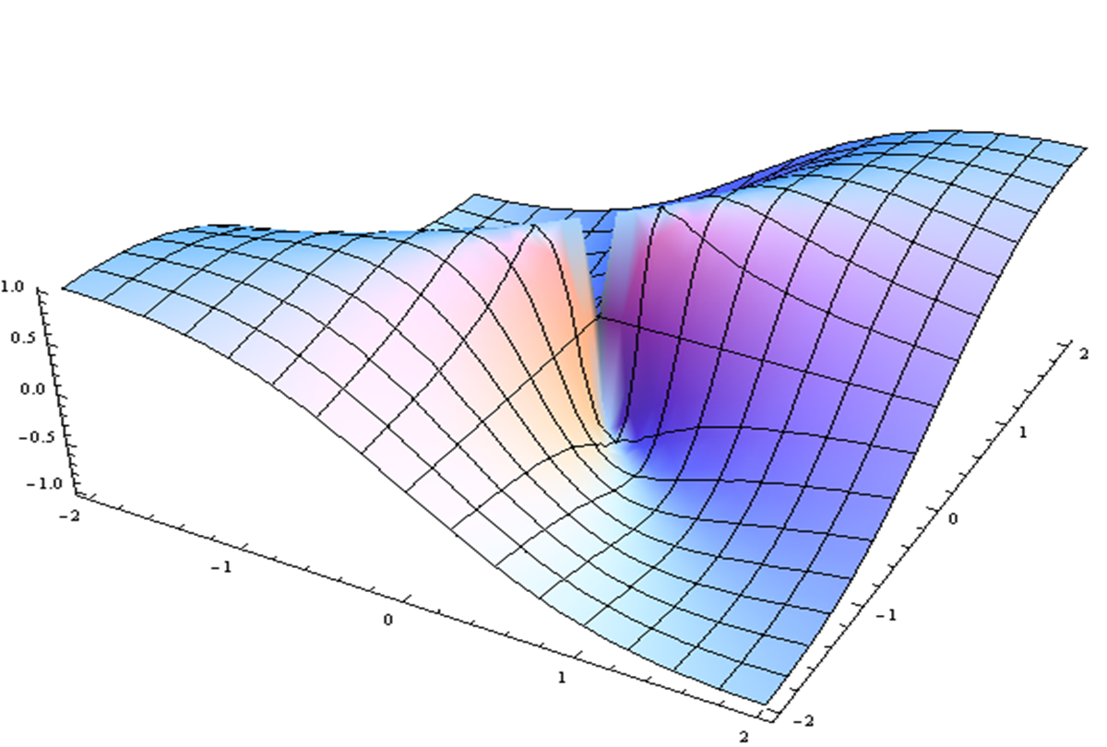
Addiction Overview & Prioritized Research
David Loveland
Reactors: Jane Liebschutz, Ajay Wasan

Slide 2
Disengaging People with a Opioid Use Disorder (OUD) – Present System of Discontinuity
90% of people with SUD have contact with healthcare provider/ annually
8% increase in OUD related events every year since 2003
11% of People with a SUD seek tx each year (20% for OUD)
Fewer than 20%
Receive medical
Care, pregnant
Women are more
Likely be to declined
Access to MAT or
Medical care,
minorities
Less likely to
receive MAT
17% receive SUD
Tx after discharge,
24% from
hospitals,
readmit in 90
days, 50% from ED return in 12
months
35% complete a
Single episode
of SUD tx, 8%
receive
Medications,
400% increase
risk of OD
after discharge
High risk of crisis & cycling back to ED or hospital
Hospitals & EDs
SUD Treatment
PCP & FQHCs

Slide 3
Literature Reviews on MAT & OUD

Slide 4
Engaging People with an OUD in the Community – Intercept before the Crisis
Train peers/ recovery coaches to find people in jails, homeless shelters & at home after an EMS contact
Move MAT tx to the community, such with a needle exchange center (EMS can also deliver MAT)
Hospitals & EDs
Community Outreach Teams
MAT & needle exchange clinics
Bypass the Hospital & engage in MAT
(1 study – pre-post using a Opioid Use Disorder Cascade of Care Model) – Trained peers outreach workers contacted individuals in high risk areas – 59% were engaged & 42% initiated MAT
(1 study pre-post) – 124 individuals OUD and high rates of co-occurring conditions (33% had HIV, 20% homeless, >70% mental illness) – 56% were retained on buprenorphine for 12 months

Slide 5
Creating a System of Continuous Care for People with an OUD – Starting in Hospitals and EDs
Initiate tx rapidly – lower suffering by initiating buprenorphine maintenance tx in any healthcare setting
Create a “hot” handoff to a 24-hour clinic from the ED for stabilization & rapid triage to tx
Hospitals & EDs –
Bridge Clinics for Harm Reduction & Warm Handoffs
(3 RCT studies)>70% of patients receiving buprenorphine in the ED connect with SUD tx at discharge
(1 study, qualitative) – positive patient experience – noting flexibility, accessibility & linking to Peers & services
(1 study) 72% of patients receiving buprenorphine in hospital connect with tx after discharge, (1 study) found 50% reduction in 30 & 90 day readmission rates
(1 study) used a PDA (patient decision aid) to improve acceptance of medications - 3 fold increase in patients inducted on buprenorphine

Slide 6
Recovery Coaches (RCs), Peers and Coordinators Providing Door-to-Door Service
Guide individuals from the ED to either a PCP or BH provider with a peer or community outreach staff member
Hospitals & EDs
SUD Tx or PCP
(1 RCT study) – patients recovering from an overdose were 8 time more likely to receive SUD tx & MAT compared to a referral only group
(1 meta analysis – 6 RCTs) - individuals receiving community-based case management are 3 times more likely to engage in MAT
(1 study, qualitative– 2 publications) – described effectiveness of RCs working in ED to engage people with any SUD, including OUD

Slide 7
Retaining Individuals in a Continuum – Stepped Care and Medication Triage over Years
Provide stepped care models that rely on measurement-based metrics & triage of medications & counseling to hold onto patients over time
Create clinical pathways based on empirical knowledge of effective tx, dosage levels & tailoring counseling to metrics of treatment response
MAT starting in a SUD Tx Facility – Transfer to PCP
MAT in a PCP - triage with SUD tx providers or enhance SUD tx with stepped Care
(2 studies, 3 publications) – the hub & spoke model - engage in OTP & transfer to OBOTs over time - significant increase in MAT (94% in one), reductions in overdose , increase access to MAT , no increase in costs
(1 study, pre-post) – multiple PCPs in MA implemented collaborative care model for OBOTs - 12 month retention rates increased from XX to 65%
(1 study, pre-post) – medication first model in MO, 38 sites – increase access to MAT from 45% to 85% in target site, wait time was reduced from 8 days to 0, & retention increased by 24% at 1,3 & 6 months & a decrease in overall costs
(1 RCT – multiple pre-post studies) – Motivational Stepped Care developed at Johns Hopkins for individuals with an OUD in an OTP - high retention in full MSC model

Slide 8
Retaining Individuals in a Continuum – New Frontiers in Research
Center for Medicare and Medicaid (CMS) – requiring all payers to transition fee-for-service funding to Valued-Based-Payment models - substantial interest in using VBPs to transform SUD tx
Using diacetylmorphine (the 4th MAT medication) – multiple studies in Canada & Europe – part of stepped care
Shatterproof Model for Performance Metrics in SUD tx – growing interest in national set of measurable outcomes
Web & phone based technology for CBT & MAT (1 RCT) – significant increase in negative urines & tx retention
Individuals with an OUD

Slide 9
Addiction Overview & Prioritized Research
Panel Discussion:
David Loveland, Jane Liebschutz, Ajay Wasan

