Slide 1
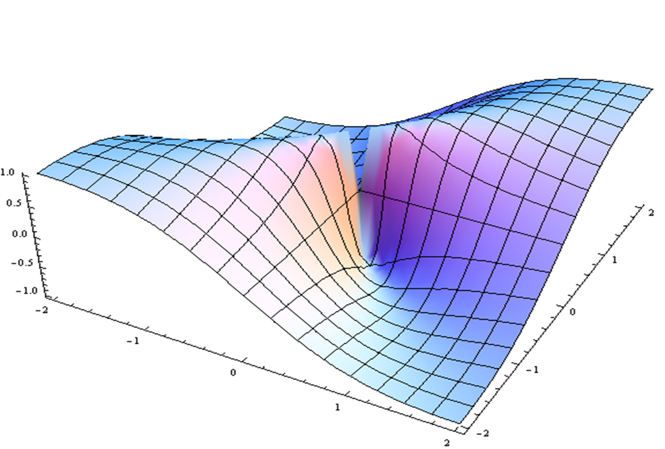
Common Pathways: Inflammation, Epigenomics, Microbiome, Dysbiosis
Yoram Vodovotz, Fabiana Ambrosio, Abbe de Vallejo, Gwen Sowa, Toren Finkel, Allison Morris

Slide 2
LM In Silico: Pros & Cons
Little or no application of Big Data / AI in LM to date
Promise of Big Data: Discover hidden patterns & relationships
Pitfalls of Big Data:
The data often are not actually “Big”
Correlation is not causality
Can’t “play” the models forward (to predict) or backward (to understand) in settings outside of the training data set
Mechanistic computational models as an alternative
Causal, dynamic, predictive, explanatory
Translational applications: In silico clinical trials, “Digital Twins”

Slide 3
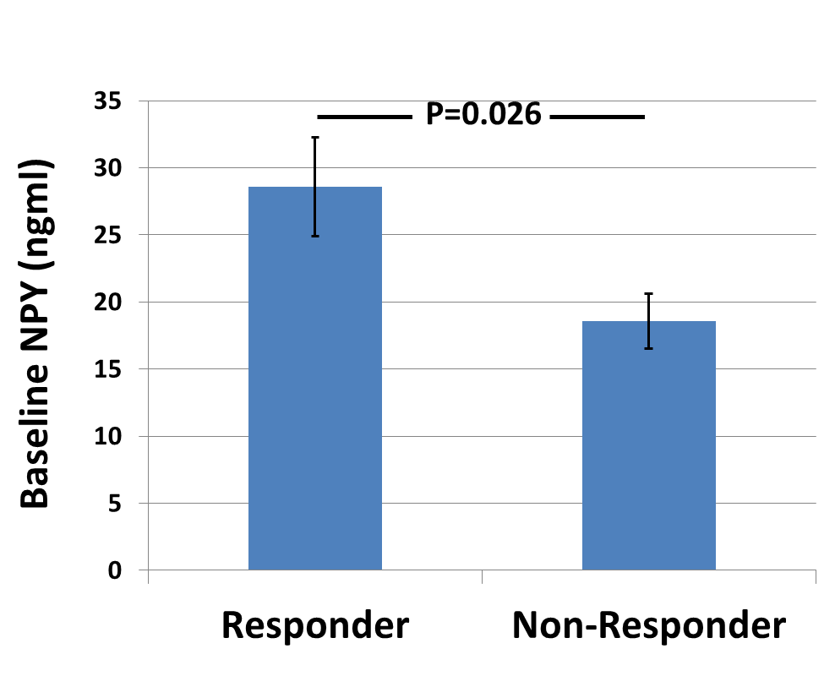
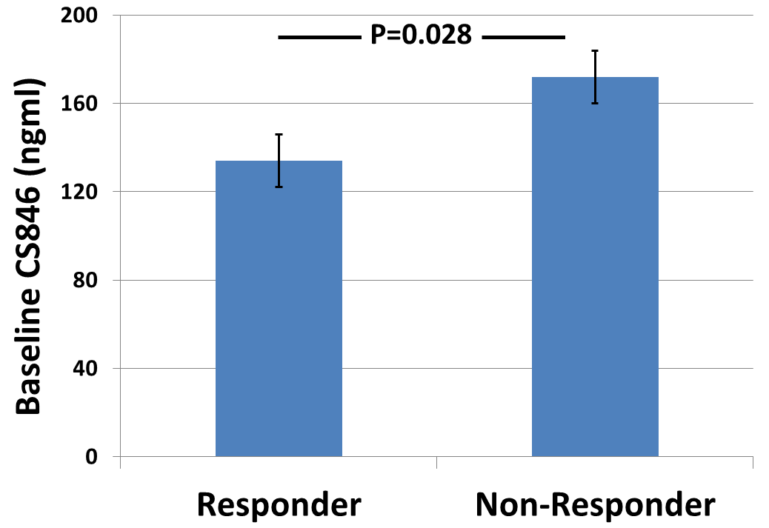
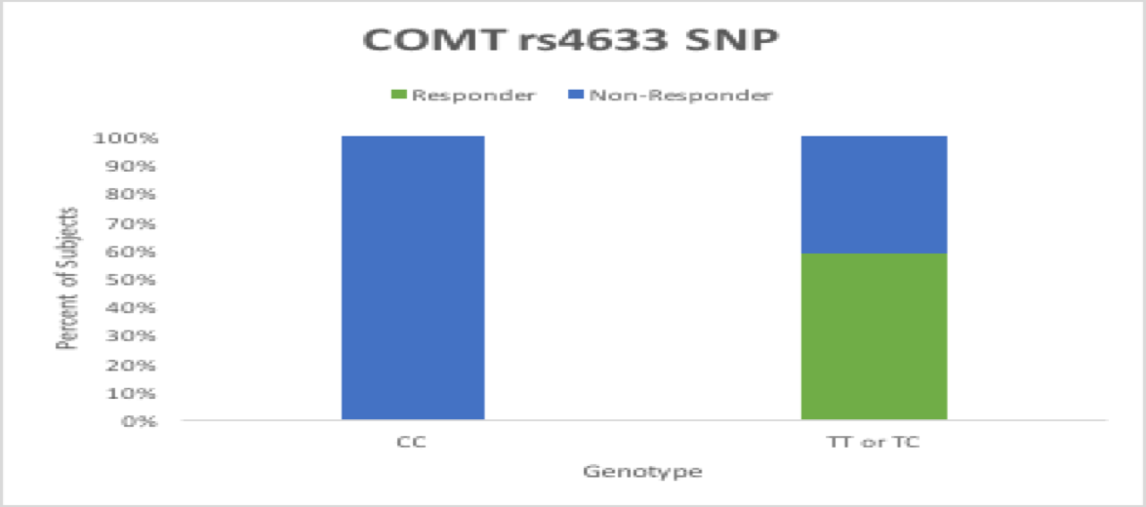
Personal Biology to Guide Treatment
Clinical data only
SNP data only
Clinical, SNP and Protein data

