Slide 1
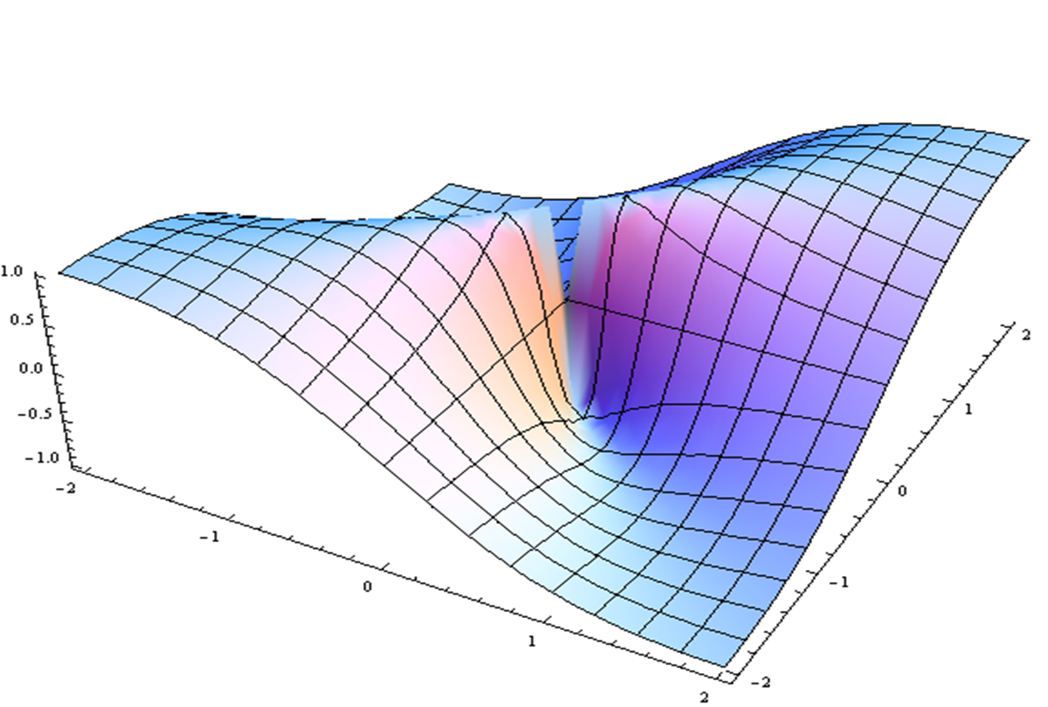
Nutrition Overview & Prioritized Research
Neal Barnard
Reactors: Frank Hu, Wayne Dysinger, Kim Williams

Slide 2
Research Recommendations in Nutrition
Neal D. Barnard, MD, FACC
Adjunct Professor of Medicine George Washington University School of Medicine President, Physicians Committee Washington, DC

Slide 3
Cardiovascular Disease
Identification of risk factors (e.g., Framingham) and means of modifying them (e.g., DASH)
Clinical trials testing dietary interventions (PREDIMED)
Reversibility (Lifestyle Heart Trial, Esselstyn studies)
Dyslipidemia + inflammation
Research priorities:
Translational studies in children
Counter disinformation efforts

Slide 4
Cancer Prevention & Survival
Identification of risk factors (NHS, EPIC, AICR/WCRF, WHO)
Gastrointestinal cancers (e.g., colorectal)
Hormonal cancers (e.g., breast, prostate)
Clinical trials for prevention (WHI)
Clinical trials for post-diagnosis (WINS, WHEL, Ornish)
Research priorities:
Prevention & survival studies (e.g., diet + exercise)

Slide 5
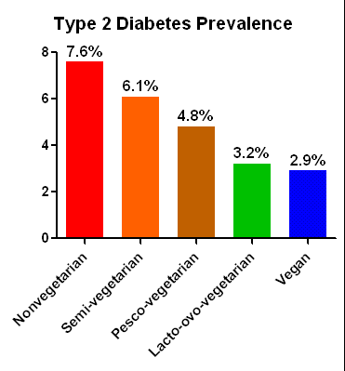
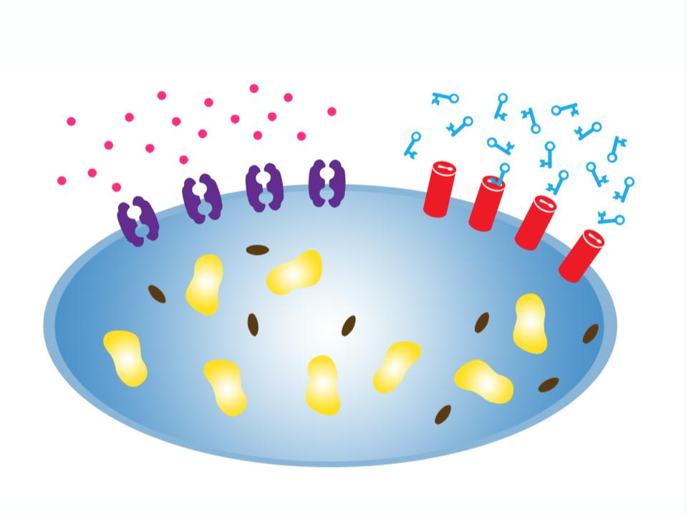
Diabetes
Type 2:
Epidemiology: diet patterns (AHS-2, NHS)
Pathology: Lipids in muscle and liver
Intervention trials with plant-based diets
Research needs: Translation, complication prevention
Type 1:
Prevention: Dairy proteins?
Research priorities: Prevention and management

Slide 6
Autoimmune Conditions
Rheumatoid Arthritis
Type 1 diabetes
Psoriasis
Multiple sclerosis
Thyroid conditions
Asthma
Sjogren’s disease
Abundant case histories.
Limited trials with plant-based diets.
Research priorities: large trials with strong interventions.

Slide 7
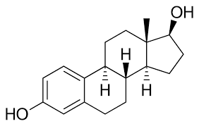
Hormonal Conditions
Fat ↑estrogens; fiber ↓ estrogens
The result is cramps, endometriosis, fibroids, infertility,
hormone-related cancers.
Thyroid disease: iodine, antibodies.
Research needs: Intervention trials

Slide 8
Brain Health
Alzheimer’s disease:
Observational studies → clinical trials:
CHAP: ↓saturated fat, ↑vegetables, fruits, vitamin E
MIND Trial, 3y study with weight-reducing diets
PMRI 40-week study, plant-based diet for early AD
More trials needed
Mood disorders: more clinical trials needed.
Attention-deficit disorder: more clinical trials needed.

Slide 9
Research Priorities
Causes, not drug targets (risks, cost, chronicity)
Strong interventions and good controls (not like WHI or WHEL)
Communities, especially children
Human biology
Beware industry-funded studies

Slide 10
Thank you!

Slide 11
Nutrition Overview & Prioritized Research
Panel Discussion:
Neal Barnard, Frank Hu, Wayne Dysinger, Kim Williams

Slide 12
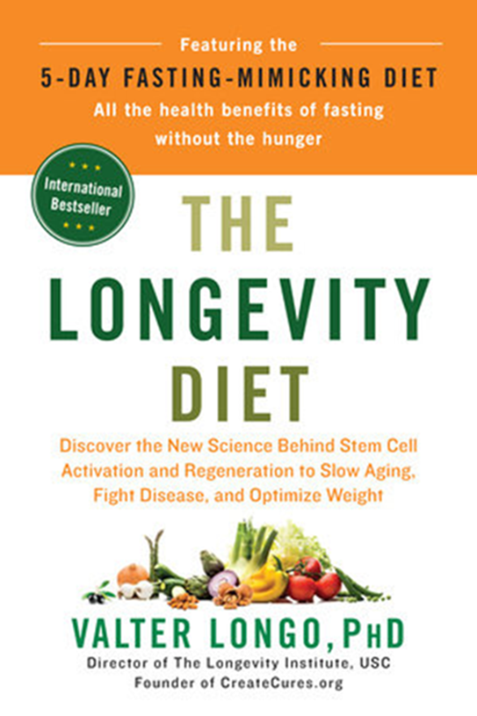
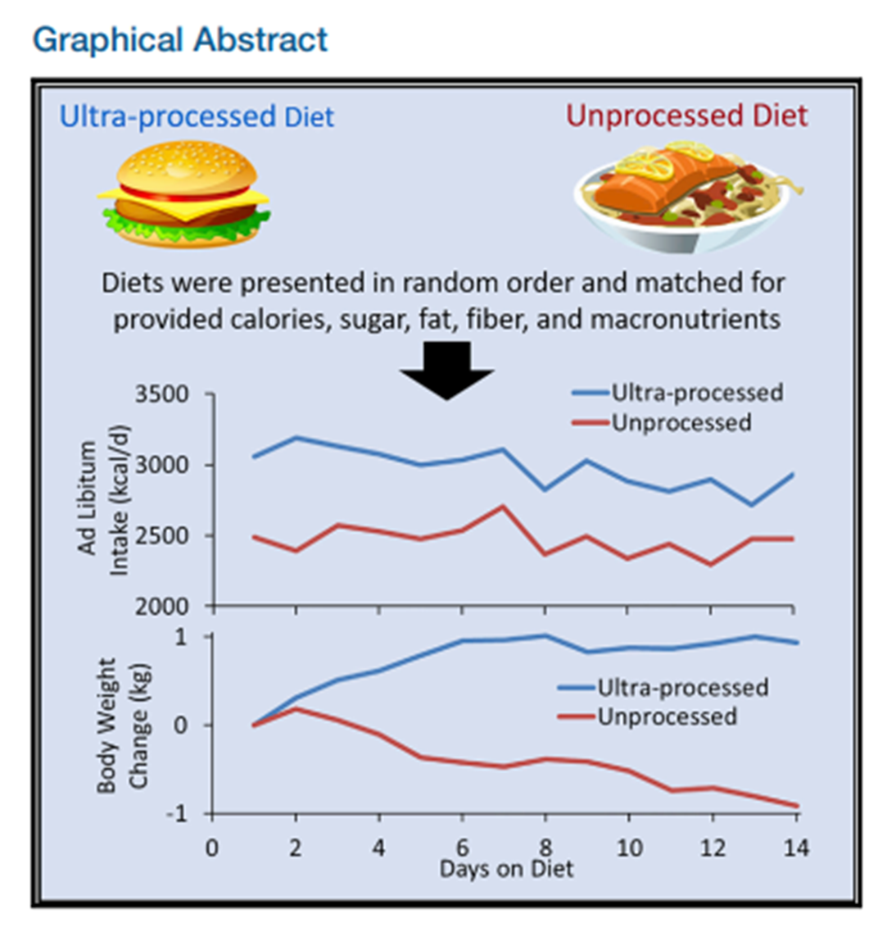
Nutrition Considerations
Eat (Whole) Food, Not Too Much, Mostly Plants
- Hall et al, Ultra-Processed Diets Cause Extra Calorie Intake and Excess Weight Gain. Cell Metabolism. 7/2019.
- Longo. The Longevity Diet. Penguin Press. 2018.
Lifestyle Medicine and Renal Disease
- Clegg & Gallant, Plant Based Diets in CKD. CJASN. 1/2019.
- Kim et al, Plant Based Diets and Incident Chronic Kidney Disease and Kidney Function. CJASN. 5/2019.

