Slide 1
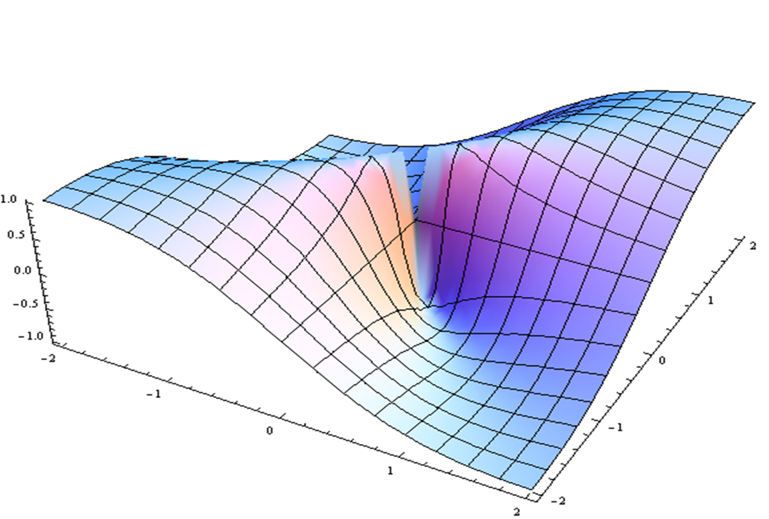
Physical Activity Overview & Prioritized Recommendations
John Jakecic
Reactors: Toren Finkel, Fabiana Ambrosio, Eddie Phillips, Gwen Sowa

Slide 2
Physical Activity Overview and Prioritized Research
John M. Jakicic, PhD
Distinguished Professor, Department of Health and Physical Activity
Director, Healthy Lifestyle Institute
University of Pittsburgh

Slide 3
Panelists
Toren Finkel, MD
Director, UPMC Aging Institute
Fabrisia Ambrosio, PhD
Department of Physical Medicine & Rehabilitation
Director of Rehabilitation for UPMC International
Eddie Phillips, MD
Chief, Physical Medicine and Rehabilitation Services, VA Boston Healthcare System
Gwendolyn Sowa, MD, PhD
Chair, Physical Medicine & Rehabilitation
Director, UPMC Rehabilitation Institute

Slide 4
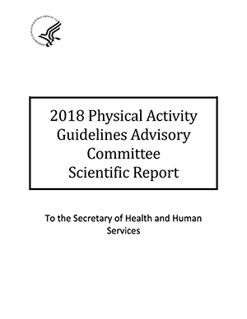
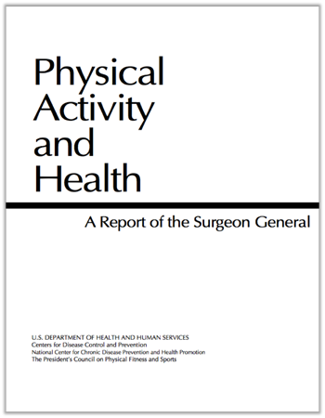
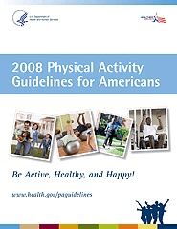

Slide 5
Physical Activity Influences on Systemic Body Systems
Adults (all ages)
All-cause mortality
Cardiometabolic conditions
Cancer
Brain Health
Weight status
Older Adults
Falls
Physical Function
Women who are Pregnant or Postpartum
Reduced excessive weight gain
Gestational diabetes
Postpartum depression
Cardiovascular system
Individuals with Pre-Existing Medical Conditions
Breast cancer - mortality
Colorectal cancer - mortality
Prostate cancer - mortality
Osteoarthritis – pain, function, quality of life
Hypertension – cardiovascular disease
Type 2 diabetes – cardiovascular mortality, disease progression, blood pressure, lipids, BMI
Multiple sclerosis – walking, physical fitness
Dementia - cognition
Impaired Executive Function - cognition
2018 Physical Activity Guidelines Advisory Committee Report

Slide 6
Relationship of Moderate-to-Vigorous Physical Activity to All-Cause Mortality
2018 Physical Activity Guidelines Advisory Committee Report

Slide 7
Relationship of Moderate-to-Vigorous Physical Activity to Chronic Conditions
2018 Physical Activity Guidelines Advisory Committee Report

Slide 8
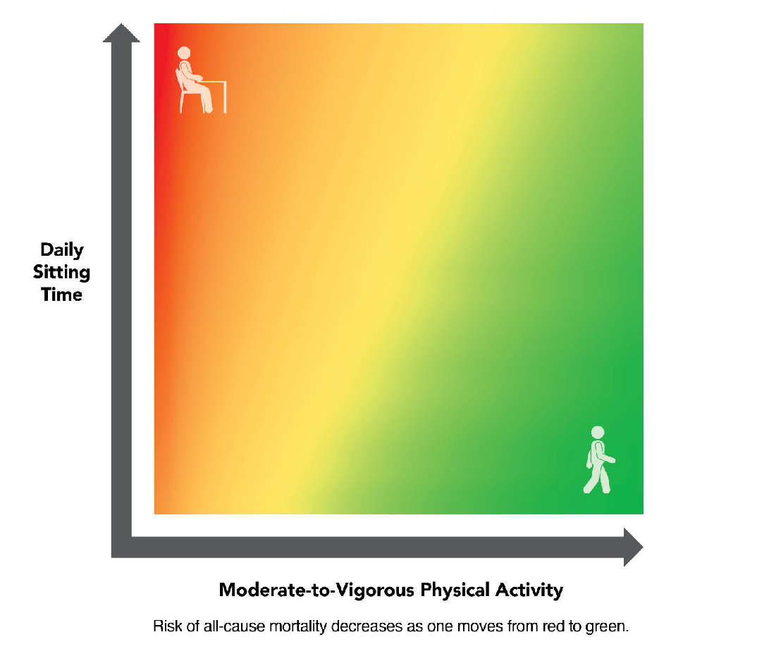
Sedentary Behavior vs. Moderate-to-Vigorous Physical Activity
2018 Physical Activity Guidelines Advisory Committee Report

Slide 9
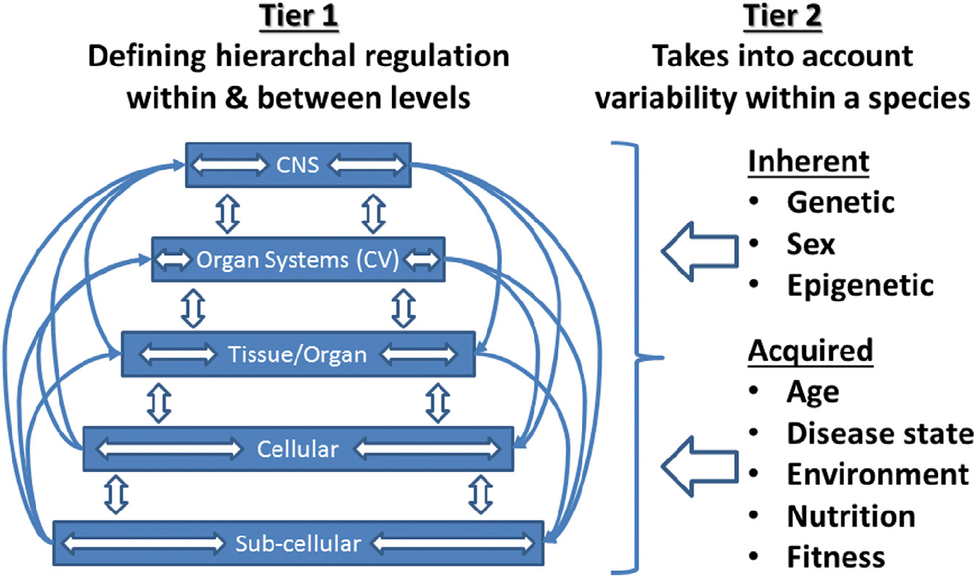
Model of Systems Control in Response to Physical Activity
Neufer PD, et al. Understanding the cellular and molecular mechanisms of physical activity-induced health benefits. Cell Metabolism. 2015; 22(1): 4-11.

Slide 10
Key Research Questions
Determine the independent and interactive effects of physical activity and sedentary behavior on multiple health outcomes in youth, adults, and older adults.
Determine the role and contribution of light-intensity physical activity alone or in combination with moderate-to-vigorous physical activity to health outcomes.
Strengthen the understanding of dose-response relationships between physical activity and multiple health outcomes in youth, adults, and older adults, and especially during the life transitions between these categories.
Expand knowledge of the extent to which the relationships between physical activity and health outcomes are modified by demographic factors, including sex and race/ethnicity.
Determine the interactive effects of physical activity and sedentary behavior with other lifestyle factors on multiple health outcomes in youth, adults, and older adults.
Determine the biological/molecular/cellular responses to physical activity and sedentary behavior that may explain the variability in inter-individual response.
Identify effective intervention strategies for increasing physical activity through actions in multiple settings in youth, adults, and older adults. Determine how the effectiveness of interventions differs by sex, age, race, ethnicity, socioeconomic status, and other factors.

Slide 11
Physical Activity Overview & Prioritized Recommendations
Panel Discussion:
John Jakecic, Toren Finkel, Fabiana Ambrosio, Eddie Phillips, Gwen Sowa

Slide 12
2018 Physical Activity Guidelines Advisory Committee Scientific Report
Evaluated additional scientific evidence over last 10 years
In addition to disease prevention benefits, “physically active individuals sleep better, feel better and function better.”
150 minutes/week moderate-intensity activity or 75 minutes/week of vigorous-intensity (or combination)
Twice weekly resistance exercise.
“There is abundant evidence that physical activity is a ‘best buy’ for public health.”
The most important question is how to increase PA levels.

Slide 13
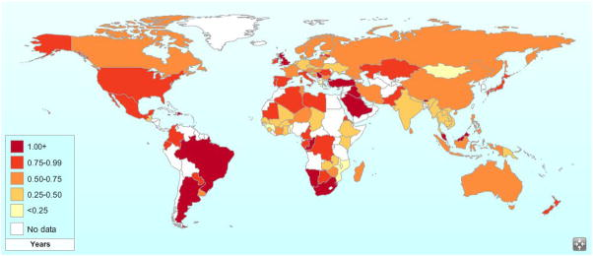
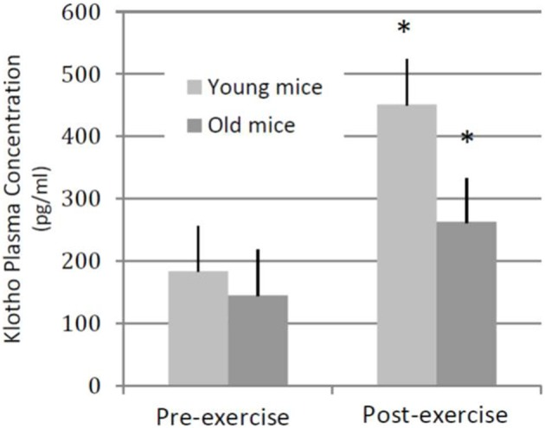
Physical Activity
Exercise is Medicine
Exercise is Anti-Inflammatory
Young muscle after
injury
Old muscle after
injury
Exercise is Regenerative

