Slide 1
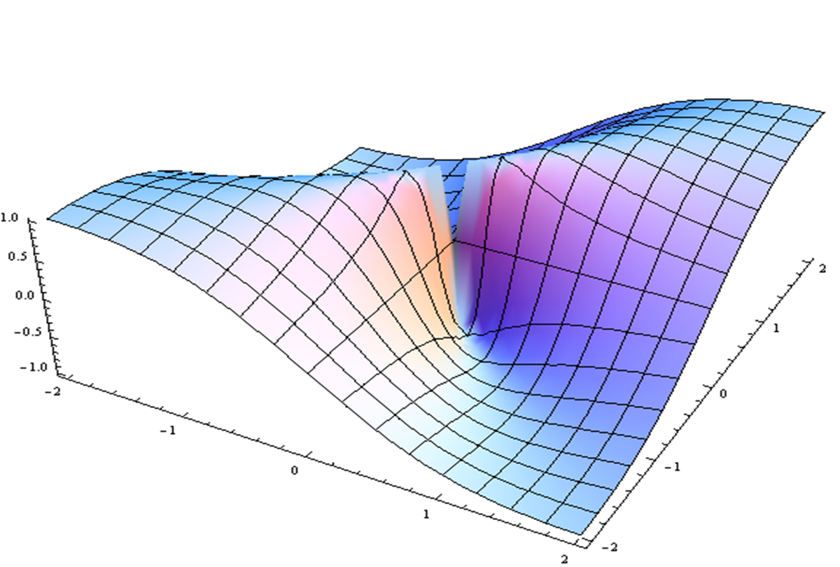
Stress/Resilience/Mindfulness Overview & Prioritized Research
Eva Szigethy
Reactors: Barry Kerzin, Loren Roth, Larry Wechsler

Slide 2
Mindfulness/Stress/Resilience Overview and Prioritized Research
Eva Szigethy MD PhD
Professor of Psychiatry, Medicine, and Pediatrics
University of Pittsburgh
UPMC Program for Gut-Brain Health
UPMC IBD Total Care Program
Behavioral Director, UPMC Chief Medical and Scientific Office

Slide 3
Conflict of Interest Disclosure (over the past 24 months)

Slide 4
Objectives
Current Knowledge
Understand the stress response and how it can be countered by the relaxation response to reduce allostatic load and increase resilience.
Describe mind-body therapies (MBTs) like mindfulness and adaptive coping as a means to achieving the 3 Rs: (Reduced stress, Relaxation, Resilience).
Impactful Research
3. What are the questions and methodologies needed to advance health promotion in this area?

Slide 5
Current Knowledge: Acute Stress Response
The response to stress is designed to help ensure survival of the organism (safety to danger)
Acute stress activates the fight/flight response resulting in cascade of healthy reactions in our brain and body
Physiological adaptive response to a “stressor” or adverse internal or external event.
Increased muscle efficiency
Sympathetic Nervous System

Slide 6
Current Knowledge: Chronic Stress Response
With prolonged stress:
Negative impact on body’s organs, mental functioning & immune system.
Impact on immune system which impedes immune system from destroying viruses, bacteria, tumors & irregular cells.
Increased risk of disease (e.g. CVD, IBS (microbiome), Cancer, depression, obesity.
Epigenetic effects
Notes:
Chronic stress causes cell damage (shortened telomeres) Epel 2004

Slide 7
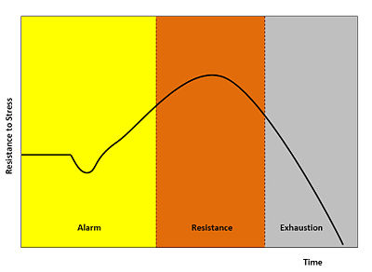
Current Knowledge: Allostatic Load versus Resilience
Allostasis
Resilience
Maintaining stress and adaptive responses over the long term implies high levels of activation of the homeostatic processes
This causes wear and tear, called 'allostatic load’.
A dynamic trait- the ability to cultivate adaptive responses by reducing negative effects of stress and returning to a state of well-being.
Ability to respond to an adverse situation and return to baseline state of optimal health.
Resting response level
Selye's General Adaptation Syndrome Diagram
Notes:
“One of the most interesting findings emerging from the research ... is that in the absence of supportive care, stressors experienced during sensitive periods of development can ... leave permanent imprints in the neural substrate of emotional and cognitive processes. ... the nervous system of mammals carries their singular epigenetic history and expresses it in unique but predictable ways”.
Reference: Gunnar M, Quevedo K. The neurobiology of stress and development. Annu Rev Psychol 2007; 58: 145-173.

Slide 8
Current Knowledge: Stress Response versus with Relaxation Response
Perceived Stress
Behavioral Response to Stress
Genes
Experience
Stress and relaxation responses are innate protective and adaptive responses that initiate physiologic and biochemical reactions in the body.
When stress is prolonged it becomes harmful but relaxation response can reverse effects of allostatic load.
Allostasis
Physiologic Biochemical Immune Response
Adaptation
Chronic Stress Response
(Sympathetic)
DANGER
Relaxation Response
(Parasympathetic)
SAFETY
Allostatic
Load
Adapted from McEwen (1998) and Dusek & Benson (2009)

Slide 9
Current Knowledge: Mind-Body Therapies (MBTs) to Achieve 3 Rs (Reduced Stress, Relaxation, Resilience)
MBTs associated with reduced stress response and increased relaxation response and increased resilience:
Movement (Yoga, Tai Chi, Exercise)
Mindfulness/Meditation (Breath awareness, Body Scan, Guided Imagery, Contemplation, Prayer, Loving Kindness)
Adaptive Coping (Cognitive Behavioral Therapy)
MBTs have been shown to have positive effects on chronic pain syndromes, inflammation, IBS, CVD, cancer, migraines, osteoarthritis, PTSD, anxiety, and depression.

Slide 10
Mind-Body Therapies: Resetting system from danger back to safety

Slide 11
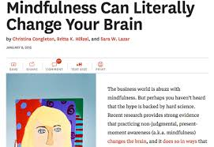
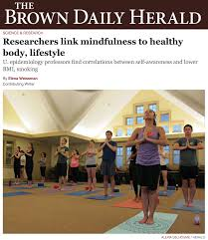
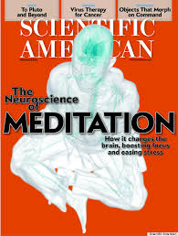
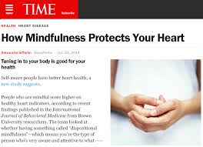
Current Knowledge: Mindfulness Meditation
Mindfulness training fosters attention and acceptance toward one’s present moment experience.
Focusing one's awareness on the present moment, while calmly acknowledging and accepting one's feelings, thoughts, and bodily sensations.
Characterized by curiosity, openness and acceptance toward one’s own experiences, as they occur.

Slide 12
Current Knowledge: Adaptive Coping- Cognitive Behavioral Therapy (CBT)
CBT teaches adaptive coping by reappraisal of (negative) thinking and changing maladaptive behaviors.
CBT techniques include relaxation, problem-solving, behavioral activation, and cognitive reframing.
CBT improves mood and leads to reversal of effects of chronic stress on brain (anxiety/depression/PTSD) and body (chronic physical symptoms).
COGNITIONS
(Thoughts)
EMOTIONS
(Feelings)
CBT
BEHAVIOR
(Action)
BODY REACTIONS
(Physical Symptoms

Slide 13
Current Knowledge: Biological Effects of Meditation and CBT
Associated with changes in brain activity and body metabolism like blood flow, muscle recovery, inflammation and gut functioning.
Resets brain-body balance
Resets autonomic nervous system
Reverses chronic stress
Reduces effects of brain trauma
Improved sleep

Slide 14
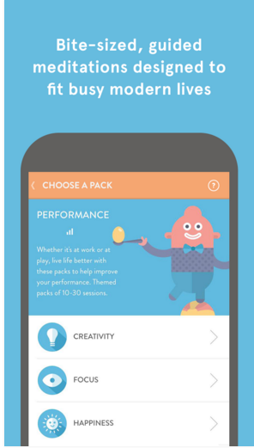
Current Knowledge: Technology-enhanced Meditation
Guided meditation and mindfulness training
General stress or targeted areas- sleep, pain, etc.
Available on smartphone
Allows you to adjust length of time of trainings
Tracks your progress
Guided and unguided mindfulness meditations to sleep, relax, retrain breathing
Available on smartphone
Can choose different lengths of sessions from 2 to 20 minutes

Slide 15
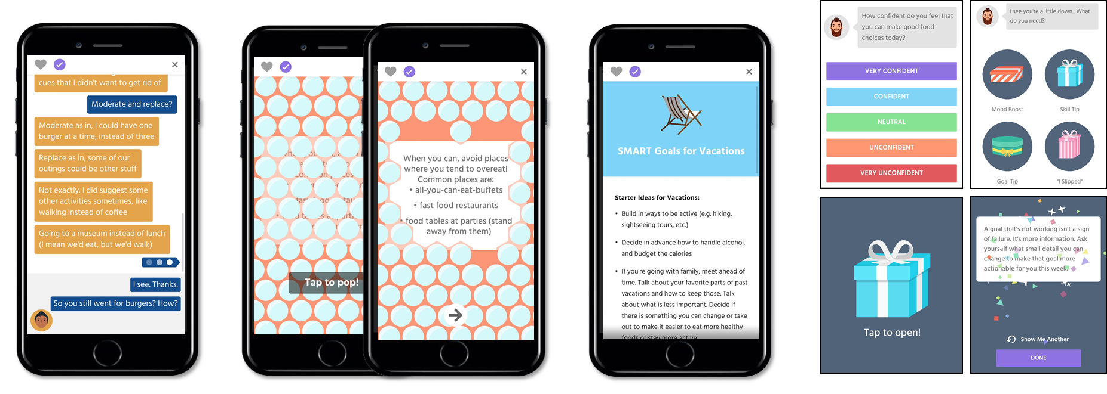
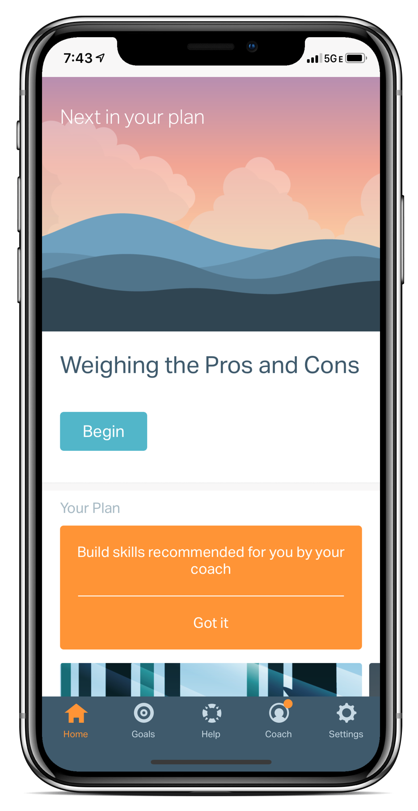
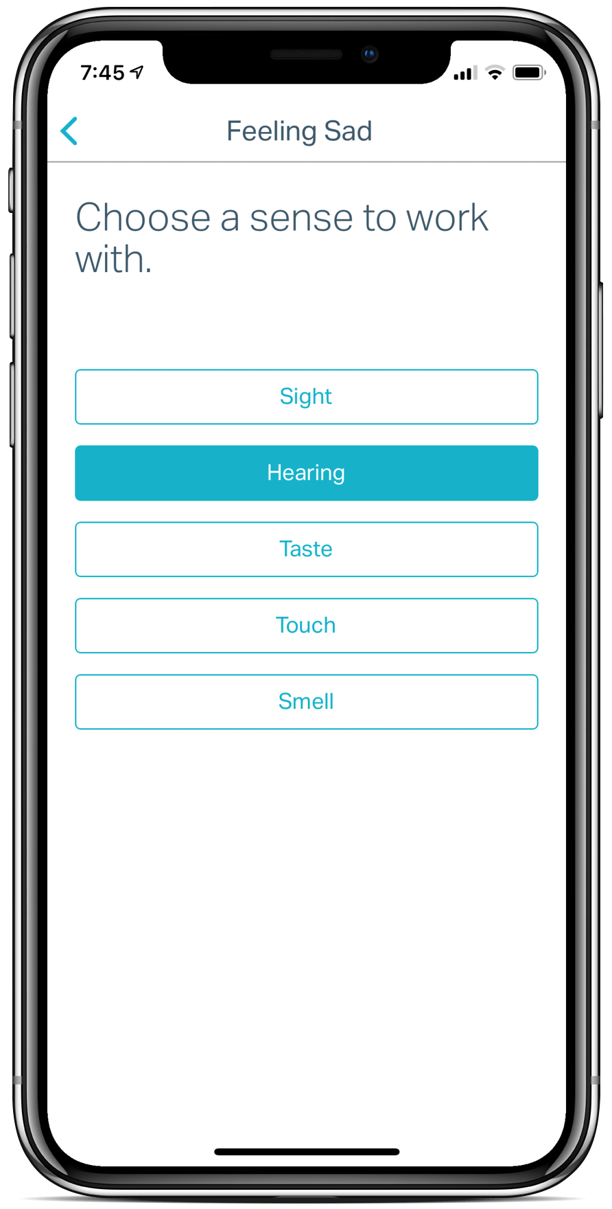
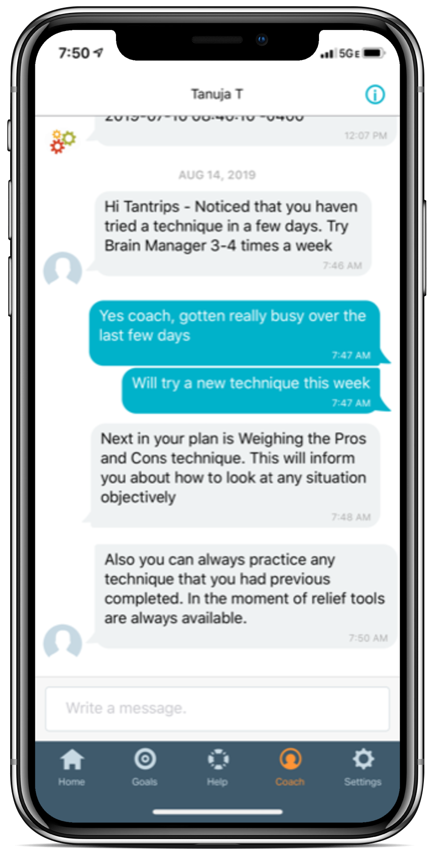
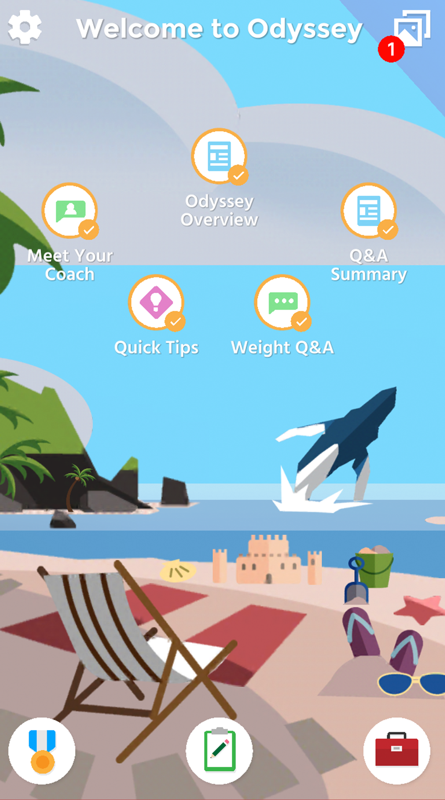
Current Knowledge: Technology-enhanced CBT
Brain Manager is a digital therapeutic program that combines in-app CBT and meditation techniques for stress, anxiety and depression with coaching support.
Integrated into UPMC electronic health record so easy for clinicians to order and to monitor patients’ usage and symptom progress.
Our programs are based on decades of scientific research and tested with people like you to make sure they are effective.
Odyssey is a mobile app that delivers wellness programs like stress management.
Empowers UPMC Health Plan members to make positive lifestyle changes through evidence-based, personalized digital interventions on a mobile device.
Many tools for behavior change such as animated character chats, gamified tips, blog posts, and adaptive interactions.

Slide 16
Summary: Achieving Resiliency
PROXIMAL OUTCOME
Adapted from Loiselle et al. (2017)
Mind-Body Therapies
(Mindfulness CBT)
Relaxation Response
Reduced Stress Reactivity
DISTAL OUTCOME
RESILIENCY
Increased Connectedness to Self and Others
Growth Enhancement
(Positivity Acceptance
Empathy
Gratitude
HEALTH
STATE
TREATMENT APPROACHES

Slide 17
Summary: Take Home Points
Chronic stress/allostatic load can be countered by relaxation.
Mind-Body Therapies (MBTs) like mindfulness and CBT promote reduction of stress, relaxation and resilience,
Building resilience by practicing MBTs involves changes at epigenetic, biochemical, physiologic, psychologic and behavioral levels.

Slide 18
Impactful Research Questions and Methodologies
QUESTIONS/CHALLENGES | METHODOLOGIES
Heterogeneity in how stress/allostatic load paradigms and indices of adaptation/resilience are defined | Consensus determined consistent definitions and measurements across multiple domains. Movement from efficacy to effectiveness. research from small samples to populations
Lack of standardization of MBTs across studies and mediators of their positive effects (e.g., physiologic, biochemical, brain & body organ level, immune, microbiome, epigenetic, psychological, behavioral) | Determination and standardization of “active” components of MBTs. Consistent domains of biological and psychological outcomes and mediators. GENES to CELLS to ORGANS to NETWORKS to ORGANISM

Slide 19
Impactful Research Questions and Methodologies
QUESTIONS/CHALLENGES | METHODOLOGIES
Differentiation of short-term and long-term outcomes in stress reduction and increased resilience and differentiating response from remission and relapse prevention. | More longitudinal studies Big data (large multi-centered trials)
Better incorporation of health-technologies to increase access to MBTs, scalability, and predictive capacity to identify at-risk populations to move from treatment to prevention. | Evaluation of effectiveness of technology-enhanced behavioral interventions Machine-learning for better predictive analytics to personalize interventions.

Slide 20
References
Loiselle E, Mehta D, Proszynski J. Behavioral Approaches to Manage Stress. Chapter 23 in James Rippe (ed) Textbook on Lifestyle Medicine. 2017; pgs 281-298.
Harkness KL, Monroe SM J Abnormal Psychology 2016; 125:727-745.
DeWilde C, Carrington J, Abatte A et al. J Transcultural Nursing 2019; 30:478-491.
Del Giudice M, Buck L, Chaby LE et al. Integrative and Comparative Biology 2018; 58:1019-1032.
Kranner I, Minibayeva FV, Beckett RP, Seal CE. New Phytologist 2010; 188:655-673.
Miller GE, Blackwell E. Curr Dr Psychol Sci. 2006;15:269-272.
Galland L. J Med Food 2014: 17:1261-72.
Epel ES, Blackburn EH, Lin J et al. Proc Natl Acad Sci. 2004; 101:17312-5.
McEwen BS. NEJM 1998; 338:171-179.
Dusek JA, Benson H. Minn Med. 2009;92:47.
Park ER, Traeger L, Vranceanu A-M. et al. Psychosomatics 2013; 54:165-174.
Khoury B. Sharma M, Rush E. J Psychosomatic Res 2015; 78:519-28
Tang YY, Holzel BR, Posner MI. Nat Rev Neurosci. 2015; 16:213-225.
Chin B., Lindsay EK. Greco CM. Health Psychol. 2019; 38:759-68.
Oser M, Wallace ML, Solano F, Szigethy E. JMIR Mental Health 2019; 6:e11981

Slide 21
Stress/Resilience/Mindfulness Overview & Prioritized Research
Panel Discussion:
Eva Szigethy, Barry Kerzin, Loren Roth, Larry Wechsler

