Slide 1
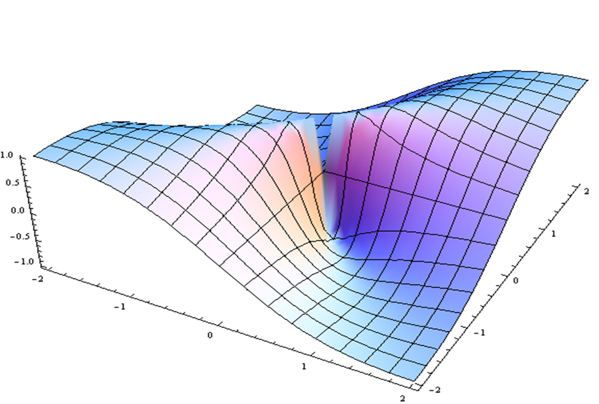
Positive Psychology and Social Connectivity Overview & Prioritized Research
Liana Lianov
Reactors: David Katz, Eva Szigethy, Marcel Salive

Slide 2
Positive Psychology and Social Connectivity: Overview and Prioritized Research
Advancing the Foundation for Health Behaviors & Well-Being
Liana Lianov, MD, MPH, FACPM, FACLM, DipABLM
Lead Faculty, Lifestyle Medicine Core Competencies Curriculum
Lead Faculty, Physician and Health Professional Well-Being Program
Chair, Positive Health and Happiness Science Committee
American College of Lifestyle Medicine
Vice-Chair, American Board of Lifestyle Medicine
President, Positive Health and Wellness Division, International Association of Positive Psychology

Slide 3
Objectives
Current Knowledge
Summarize key studies on the health impact of positive psychology interventions and social connectivity
Impactful Research Questions
Identify research questions that need to be addressed in order to implement positive psychology and social connectivity as a pillar of lifestyle medicine for facilitating total well-being
Lianov, L.
Positive Psychology,
Social Connectivity

Slide 4
Current Knowledge
Lianov, L.
Positive Psychology,
Social Connectivity

Slide 5
Key Studies in Positive Psychology and Health
Topic: Subjective well-being (prefrontal cortex processing)
Diener 2011: Subjective well-being (e.g. Satisfaction with Life Scale) is associated with health and longevity
Topic: Positive emotion (amygdala processing) and health behavior
Van Cappellen et al. 2018: Upward spiral theory of lifestyle change In which positive emotion promotes healthy lifestyle choices
Lianov, L.
Positive Psychology,
Social Connectivity

Slide 6
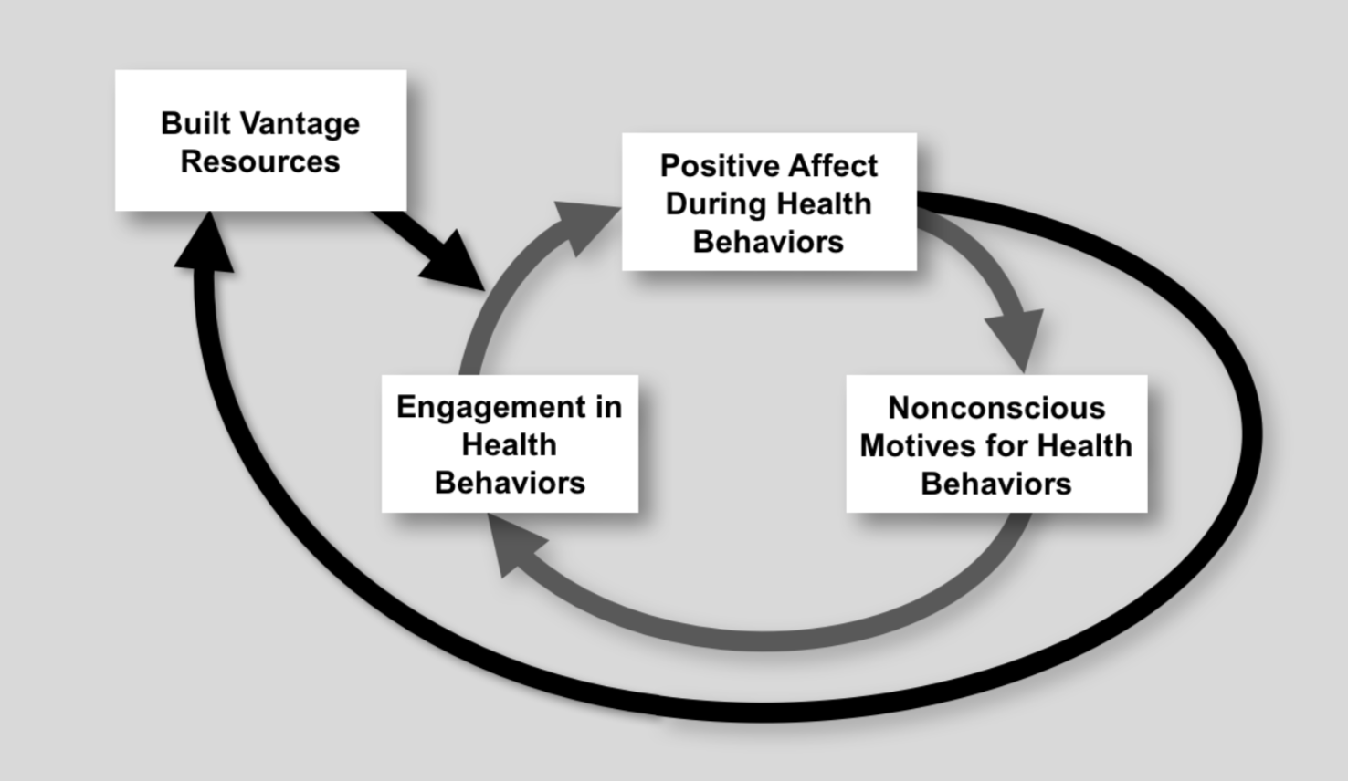
Upward Spiral Theory of Lifestyle Change Van Cappellen et al. 2018
Lianov, L.
Positive Psychology,
Social Connectivity

Slide 7
Key Studies in Positive Psychology and Health
Positive Psychology Interventions (PPIs): Hendriks 2018: Meta-analysis of PPIs (19 different PPIs e.g. gratitude, forgiveness, savoring) shows small, but significant, impact on psychological and subjective well-being (which can have physical health benefits)
Topic: Positive activities and health, example of gratitude
Emmons et al. 2003; Lai 2017: Three good things/gratitude is associated with psychological and physical sense of well-being
Topic: Purpose and meaning
Kim et al. 2013, 2014: a sense of purpose and meaning is associated with:
Higher use of preventive services
Lower CVD mortality risk in those who already have the disease
Lianov, L.
Positive Psychology,
Social Connectivity

Slide 8
Key Studies in Social Connectivity and Health
Orth-Gomér 1993: Both the number and quality of relationships are important to well-being.
House et al. 1988, 2001; Cacioppo & Hawkley 2003; Tomaka et al. 2006: Social isolation is associated with poor health, especially in the elderly.
Barnes et al 2004; Brummet et al 2001; House 2001; Seeman 2000; Uchino et al.1996: Social isolation was associated with greater all-cause mortality; increased morbidity; lower immune system function; depression, and cognitive decline
Berkman & Syme 1979; Dean et al. 1992; Hawkley et al. 2006; Krause 1987; Thoits & Hewitt 2001: Indicators of social isolation (such as living alone, having a small social network, participating in few social activities, feelings of lack of social support and loneliness) are associated with poor health.
Lianov, L.
Positive Psychology,
Social Connectivity

Slide 9
Key Studies in Social Connectivity and Health
Cohort Studies:
Alameda cohort study: After 17 years, those who had closest social ties, as well as healthful behaviors, lived the longest.
Roseto (Pennsylvania) study: Those with risk factors and close social/community ties, lived longer than those with similar risk factors and fewer social ties.
Harvard Study on Adult Development (over 80 years and ongoing): Controlling for a host of confounders, social connectedness is the most powerful predictor of health and longevity.
Lianov, L.
Positive Psychology,
Social Connectivity

Slide 10
Social Connectivity and Health: Studies on Mechanisms of Action
Health Behaviors:
Umberson et al. 2006; Wickrama et al. 2001: Social networks can support healthy behaviors.
Immune System:
Cohen et al. 1997: Social connectivity boosts immune system (in this case: the common cold).
Endocrine System:
Ozbay et al. 2007: Social connection impacts the hypothalamic-pituitary-adrenocortical and noradrenergic systems and central oxytocin pathways for beneficial health effects.
Lianov, L.
Positive Psychology,
Social Connectivity

Slide 11
Social Connectivity and Health: Studies on Mechanisms of Action
Parasympathetic Nervous System (“Tend and Befriend” instead of “Fight or Flight”):
Sandstrom & Dunn 2013: Social interaction, even with a weak social tie (e.g. barista), promoted positive affect, which was mediated by feelings of belonging.
Fredrickson et al. 2008, 2013: Positive emotions, mediated through loving kindness meditation, build consequential personal resources that can support health.
Kok et al. 2010, 2013: Micro-moments of connectivity have beneficial health effects via. positivity resonance. Positivity resonance provides direct physiologic benefits: improved vagal tone and increased heart rate variability.
Lianov, L.
Positive Psychology,
Social Connectivity

Slide 12
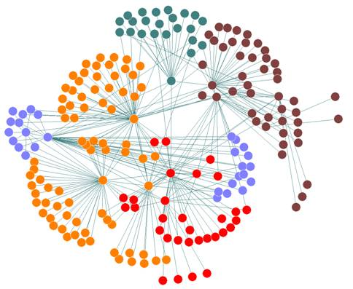
Social Connectivity and Health: Studies on Mechanisms of Action
Social Networks:
Fowler & Christakis 2008: The spread of happiness occurs in social networks.
(Christakis & Fowler 2007: The spread of obesity occurs in social networks.)
Lianov, L.
Positive Psychology,
Social Connectivity

Slide 13
Summary of Logic Model
Mind-body therapies
(Mindfulness, CBT)
PROXIMAL OUTCOME
Adapted from Loiselle et al. 2017
Relaxation response, “tend and befriend”
DISTAL OUTCOME
Reduced stress reactivity
RESILIENCY & TOTAL WELL-BEING
(physical, mental, emotional, social, and positive health)
Growth enhancement in positive psychology framework:
positive emotions, positive activities, relationships, meaning, and accomplishment (e.g. acceptance, empathy, gratitude)
Upward spiral of lifestyle change, increased connectedness to self and others,
HEALTH
STATE
TREATMENT APPROACHES

Slide 14
Impactful Research Questions
Lianov, L.
Positive Psychology,
Social Connectivity

Slide 15
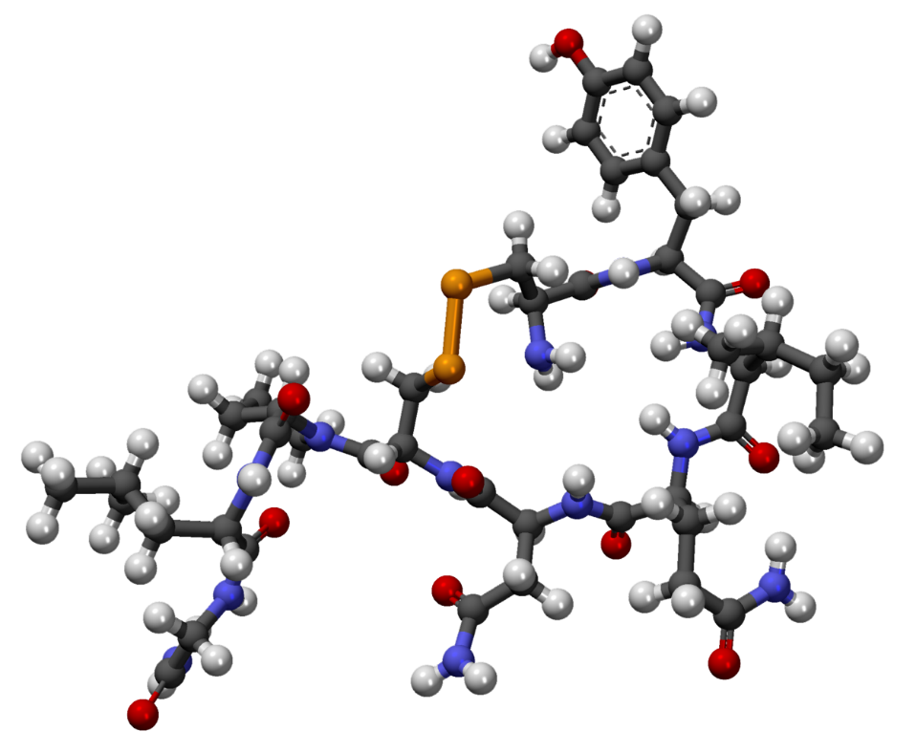
Basic Science/Physiology Research Questions
What are the biological/physiological mechanisms of actions underlying specific positive psychology interventions (PPIs) and social connectivity?
What are the mechanisms of action by which each pillar of a healthy lifestyle impacts emotional well-being?
Lianov, L.
Positive Psychology,
Social Connectivity

Slide 16
Clinical Research Questions
Note: We need to develop consistent, standard terminology to advance interdisciplinary research.
What are the physiological, neurological and psychological outcomes of key positive psychology interventions (e.g. positive emotions, engagement, relationships, meaning and accomplishment) when used as part of treatment in health care settings? How do these interventions interact to effect outcomes?
What strategies can be implemented in healthcare/lifestyle medicine settings to leverage the upward spiral theory of lifestyle change and demonstrate health benefits?
What are the emotional and mental health effects of each pillar of a healthy lifestyle, prescribed as part of lifestyle medicine?
Lianov, L.
Positive Psychology,
Social Connectivity

Slide 17
Population Level Research Questions
What kind of community environments promote and support the beneficial health effects of positive psychology-based activities and social connectivity?
What public health/population level interventions can be implemented to support positive psychology and social connectivity interventions prescribed/recommended as part of healthy lifestyle treatments?
Lianov, L.
Positive Psychology,
Social Connectivity

Slide 18
Examples of Research Needed in Positive Psychology and Health
What are the nuanced health effects of positive affect? (Do high arousal positive words. e.g. “vitality” in self-rating mood reflect underlying physical vitality? Or do they independently convey physiological benefits? (Pressman et al. 2005, 2019)
What are the health benefits of positive prefrontal cortex versus amygdala processing (subjective well-being vs. emotional states of happiness)? Which to pursue as part of well-being treatment?
What are the cultural differences in the health effects of high arousal versus low arousal positive affect, e.g. excited vs. calm (Pressman et al. 2019); and cultural differences in health benefits of different PPIs, such as gratitude practice and acts of kindness (Layous et al. 2013)?
What are the health effects of teachable skills, e.g. hope therapy, that can be prescribed (Chan et al. 2019)?
What is the physiological impact of positive interactions/empathy in clinical encounters on health behavior, physiology and outcomes (e.g. HgbA1c) in different populations, such vulnerable subpopulations (Hojat 2011, Chaitoff et al. 2019)?
What are effective and practical strategies for identifying the best person-activity fit and optimal “dose” of positive psychology interventions, such as gratitude practice?
Lianov, L.
Positive Psychology,
Social Connectivity

Slide 19
Examples of Research Needed in Social Connectedness and Health
What is the “active ingredient” in social isolation that leads to deleterious effects and the “active ingredient” of social connection that leads to health benefits?
How do social isolation vs. feelings of loneliness differ in health effects?
Do social isolation and feelings and feelings of loneliness confer independent impacts on health? Or does social isolation simply reflect feelings of loneliness?
What are effective social intervention strategies? (visiting strangers, such as “rent a grandchild”) versus friends and family?
How can healthcare help patients adjust expectations about social relationships? (i.e. older adults can feel more satisfied with fewer connections—Lang & Carstensen 1994; Schnittker 2007; those who adjust expectations to minimize impact of feeling isolated fare better--Cornwell & Waite 2009 )
What are the short and long term health and well-being effects of social media engagement?
Lianov, L.
Positive Psychology,
Social Connectivity

Slide 20
Summary
Positive psychology interventions have been shown to improve subjective well-being, which is associated with improved health outcomes and longevity.
The biological/physiological mechanisms of action and nuances of health effects in different populations need further study.
Those study results need to be used to develop and test effective interventions in health care settings and develop a robust evidence-base.
Of the positive psychology pillars, relationships/social connectivity is shown to have the most powerful health benefits in long term cohort studies.
Effective social health interventions for health care settings need further development and testing.
The field of lifestyle medicine aims to treat and prevent disease through comprehensive lifestyle interventions and to facilitate well-being. Hence, LM is in a prime position to help build the evidence-base for applying positive psychology and social connectivity interventions in health care.
Lianov, L.
Positive Psychology,
Social Connectivity

Slide 21
References
Barnes LL, Mendes de Leon CF, Wilson RS, et al. Social resources and cognitive decline in a population of older African Americans and whites. Neurology 2004;63:2322-26.
Berkman LF, Syme L. Social networks, host resistance, and mortality: A nine-year follow-up study of Alameda County residents. American Journal of Epidemiology 1979;109:186-204.
Berkman L, Breslow L. Health and Ways of Living: The Alameda County Study: New York: Oxford University Press, 1983.
Brummett BH, Barefoot JC, Siegler IC, et al. Characteristics of socially isolated patients with coronary artery disease who are at elevated risk for mortality. Psychosomatic Medicine 2001;63:267-272.
Cacioppo JT, Hawley LC. Social isolation and health, with an emphasis on underlying mechanisms. Perspectives in Biology and Medicine. 2003;46:S39-S52.
Chaitoff A, Rothberg MB, Windover AK. Physician empathy is not associated with laboratory outcomes in diabetes: a cross-sectional study. Journal of General Internal Medicine. 2019; 34(1):75-81.
Chan K, Wong FKY, Le PH. A brief intervention to increase hope level and improve well-being in rehabilitating cancer patients: A feasibility test. Sage Open Nursing 2019;5:1-13.
Christakis N, Fowler JH. The spread of obesity in a large network over 32 years, New England Journal of Medicine 2007;357:370-79.
Cohen S, Doyle WJ, Skoner DP. Social ties and susceptibility to the common cold. Journal of the American Medical Association 1997;277:1940-44.
Cornwell EY, Waite LJ. Social disconnectedness, perceived isolation, and health among older adults. Journal of Health and Social Behavior 2009;50(1):31-48.
Dean A, Kolody B, Wood P, Matt GE. The influence of living alone on depression in elderly persons. Journal of Aging and Health 1992;4:3-18.
Diener E, Chan MY. Happy people live longer: subjective well-being contributes to health and longevity. Applied Psychological Health and Well-Being 2001;3(1):1-43.
Emmons RA, McCullough ME. Counting blessing versus burdens: an experimental investigation of gratitude and subjective well-being in daily life. Journal of Perspectives in Social Psychology 2003;84(2):377-389.
Fowler JH, Christakis NA. Dynamic spread of happiness in a large social network: Longitudinal analysis over 20 years in the Framingham Heart Study. The British Medical Journal 2008;337.:a2338.
Fredrickson BL. Positive emotions broaden and build. Advances in Experimental Social Psychology 2013;47:1-53.

Slide 22
References
Fredrickson BL, Cohn MA, Coffey KA, et al. Open heart build lives: Positive emotions, induced through loving-kindness meditation, build consequential personal resources. Journal of Perspectives in Social Psychology 2008;92:1045-1062.
Harvard Study on Adult Development: adultdevelopmentstudy.org [accessed November 25, 2019]
Hawkley LC, Burleson MH, Berntson GG, Cacioppo GG. Loneliness in everyday life: Cardiovascular activity, psychosocial context, and health behaviors. Journal of Personality and Social Psychology 2003;85:105-20.
Hawkley LC, Masi CM, Berry JD, Cacioppo JT. Loneliness is a unique predictor of age-related differences in systolic blood pressure. Psychology and Aging 2006;21:152-64.
Hendriks T, Schotanus-Dijkstra M, Hassenkhan A, et al. The efficacy of multi-component positive psychology interventions: A systematic review and meta-analysis of randomized controlled trials. Journal of Happiness Studies 2019:1-34.
Hojat M. Physicians’ empathy and clinical outcomes for diabetic patients. Louis DZ, Markham FW, et al. Academic Medicine 86(3):359-364.
House JS. Social isolation kills, but how and why? Psychosomatic Medicine 2001;63:273-74.
House JS, Landis KR, Umberson D. Social relationships and health. Science 1988;241:540-45.
Kim ES, Sun JK, Park N, et al. Purpose in life and reduced risk of myocardial infarction among older US adults with coronary artery disease: A two—year follow-up. Journal of Behavioral Medicine 2013;36(2):124-133.
Kim ES, Strecher VJ, Ryff CD. Purpose in life and use of preventive health care services. Proceedings in the National Academy of Sciences 2014;111(46):16331-16336.
Kok BE, Coffey CA, Cohn MA, How positive emotion build physical health: perceived positive social connections account for the spiral between positive emotions and vagal tone. Psychological Science 2013;24:1123-1132.
Kok BE, Fredrickson BL. Upward spirals of the heart: Autonomic flexibility, as indexed by vagal tone, reciprocally and prospectively predicts positive emotions and social connectedness. Biological Psychology 2010;85:432-436.

Slide 23
References
Krause N. Satisfaction with social support and self-rated health in older adults. The Gerontologist 1987;27:301-08.
Lai ST. “The three good things”--The effects of gratitude practice on well-being: A randomized controlled trial. Health Psychology 2017;26(1):10.
Lang FR, Carstensen LL. Close emotional relationships in later life: Further support for proactive aging in the social domain. Psychology and Aging 1994;9:315-24.
Layous K, Lee H, Choi I, Lyubomirsky S. Culture matters when designing a successful happiness-increasing activity: A comparison of the United States and South Korea. Journal of Cross Cultural Psychology 2013;44(8):1294-1303.
Loiselle E, Mehta D, Proszynski J. Behavioral Approaches to Manage Stress. in James Rippe (ed) Textbook on Lifestyle Medicine, 2017; p. 281-298.
Ozbay F, Johnson DC, Dimoulas E, et al. Social support and resilience to stress. Neurobiological Clinical Practice 2007;4(5):35-40.
Orth-Gomér K, Undén AL. Lack of social support and incidence of coronary artery disease in middle-aged Swedish med. Psychosomatic Medicine 1993;55:37-43.
Pressman S, Cohen S. Does positive affect influence health? Psychological Bulletin 2005; 131(6):925-971.
Pressman SD, Jenkins BN, Moskowitz JT. Positive affect and health: What do we know and where next should we go? Annual Review of Psychology 2019;70:627-650.
Sandstrom GM, Dunn EW. Social interactions and well-being: The surprising power of weak ties. Perspectives in Social Psychology Bulletin 2014;40:910-922.
Schnittker J. Look (Closely) at all lonely people: Age and the social psychology of social support. Journal of Aging and Health 2007;19:659-82.
Seeman TE, Berkman LF, Blazer DG, Rowe JW. Social ties and support and neuroendocrine function: The MacArthur Studies of Successful Aging. Annals of Behavioral Medicine 1994;16:95-106.
Thoits PA, Hewitt LN. Volunteer work and well-being. Journal of Health and Social Behavior 2001;42:115-31.

Slide 24
References
Tomaka J, Thompson S, Palacios R. The relation od social isolation, loneliness, and social support to disease outcomes among the elderly. Journal of Aging and Health 2006;18:359-84.
Uchino BN., Cacioppo JT, Kiecolt-Glaser JK. The relationship between social support and psychological processes: A review with emphasis om underlying mechanisms and implications for halt. Psychological Bulletin 1996;119:488-531.
Umberson D. Family status and health behaviors: Social control as a dimension of social integration. Journal of Health and Social Behavior 1987;28:306-19.
Van Cappellen P, Rice EL, Catalino LI, et al. Positive affective processes underlie positive health behavior change. Psychological Health 2018;33:77-97.
Wickrama KAS, Lorenz FO, Wallace LE, et al. Family influences on physical health during the middle years: The case of onset of hypertension. Journal of Marriage and the Family. 2001;63:527-39.
Wolf S. Predictors of myocardial infarction over a span of 30 years in Roseto, Pennsylvania. Integrative Physiological & Behavioral Science. 1992;27(3):46-57.

Slide 25
Positive Psychology and Social Connectivity Overview & Prioritized Research
Panel Discussion:
Liana Lianov, David Katz, Eva Szigethy, Marcel Salive

