Slide 1
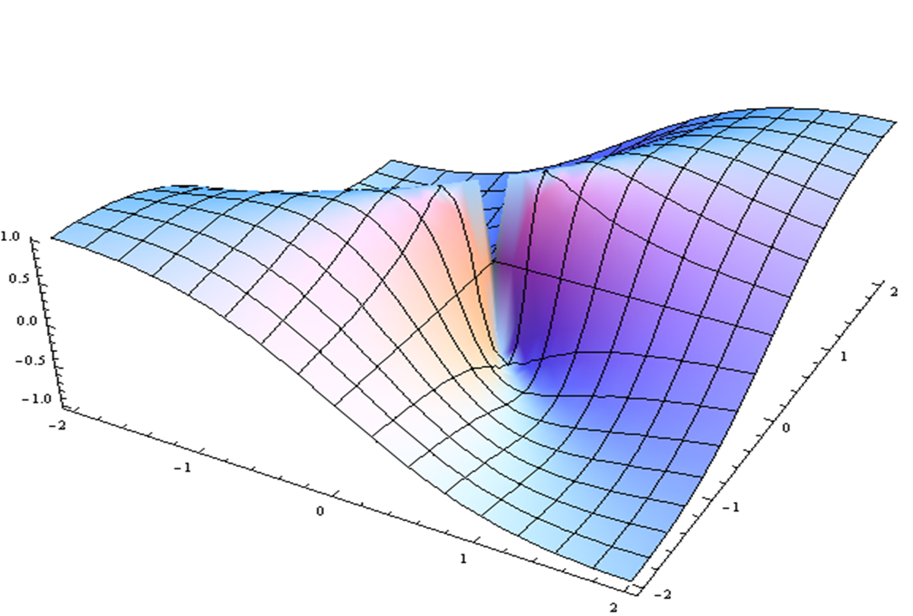
Summary & White Paper Next Steps
Mike Parkinson and Yoram Vodovotz

